Slide 1
Self-Skepticism
What the Tools of Science Tell Us About Our Thoughts, Beliefs and Decisions
Spencer Greenberg

Slide 2
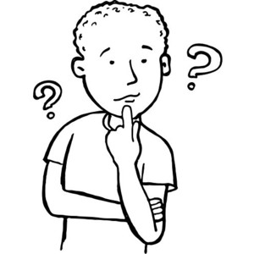
My Goals Today Are To Get You To…
Reassess your strengths and weaknesses
Question whether you understand your decisions
Doubt your beliefs about your beliefs

Slide 3
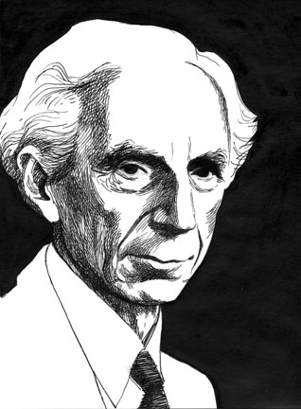
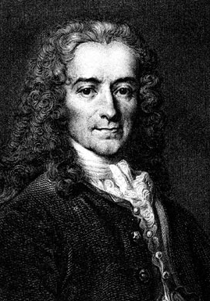
Self-Doubt Through the Ages
“Doubt is not a pleasant condition but certainty
is an absurd one.”
-Voltaire
“I think we ought always to entertain our opinions
with some measure of doubt.”
-Bertrand Russell
“To know, is to know that you know nothing.”
-Socrates

Slide 4
Self-Skepticism Developing An Understanding Of…
Strengths &
Weaknesses
Beliefs
Decisions

Slide 5
Self-Skepticism
It often takes directed effort to understand our strengths and weaknesses
-it doesn’t come as naturally as people think
Our beliefs are probably less accurate than they feel to us
-feeling true and being true are different things
We’re often unaware of the real reasons for our actions
-the reasons we give are often wrong or incomplete

Slide 6
Skepticism + Self-Skepticism
Let’s not just challenge and be skeptical of others’ beliefs
Let’s turn the tools of rationality in on ourselves
Let’s challenge and be skeptical of our own beliefs

Slide 7
My Path to Self-Skepticism
Three experiences started me down this path
You can replicate them yourself if you choose

Slide 8
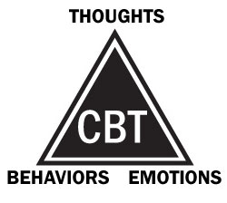
Story 1 Cognitive Behavioral Therapy
Shown effective for treating anxiety and depression
Claims we think irrationally when upset
Predicts emotion will lead to specific thinking errors

Slide 9
Typical Distortions When Upset
All or nothing thinking
"If I do a bad job with this talk, I'm worthless.”
Jumping to conclusions
“The audience looks board, they must hate me.”
Magnification
“I can’t believe I misspelled ‘bored’ on this slide. My talk is ruined.”
And seven or eight more…
Source: Feeling Good by David Burns

Slide 10
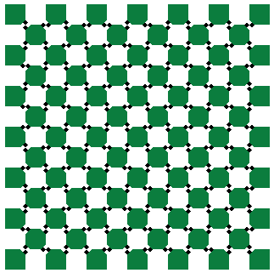
Easy To Test This Hypothesis
I wrote down my thoughts when upset
The distortions list applied to almost every thought
Realized I had far more distortions than I knew!

Slide 11
Could This Be True of You?
The claim is that this applies to nearly everyone
Says something about the brain’s general reliability
You can do this experiment on yourself!
wait until you’re upset or emotional
write down your thoughts
look carefully for irrationality and exaggerations

Slide 12
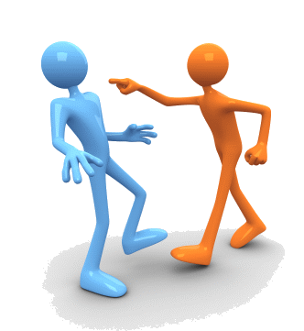
Story 2 Thinking About Disagreement
Was having a disagreement about a factual issue
Realized that the other person was
as smart as me
as knowledgeable as me
as certain as me
Why am I more likely to be right?

Slide 13
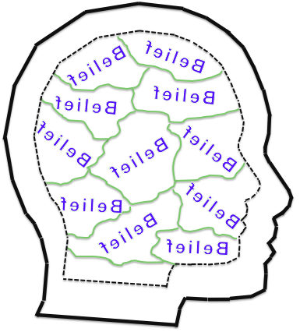
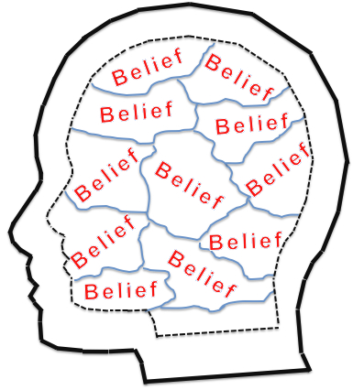
Outside Perspective
Your arguments don’t convince the other person and his arguments don’t convince you
Why should you believe your view rather than his?
Just because your brain labels it as “true” why should it be more likely to be correct?
See: What’s So Special About Your Own Beliefs by Spencer Greenberg

Slide 14
Can Justify Believing Your Beliefs By…
Using reliable methods for generating beliefs
If you do this your beliefs really are more likely to be right than those who use standard methods

Slide 15
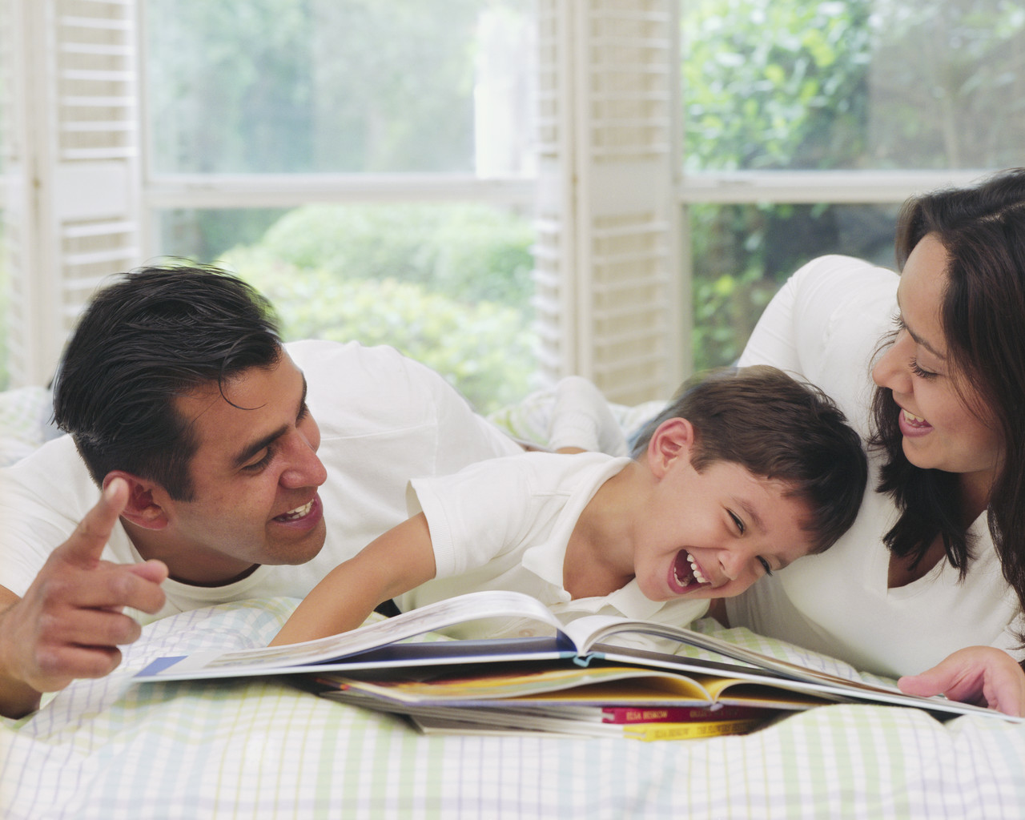
Problematic Methods
Believe whatever it is pleasing to believe
sometimes false things are pleasing
sometimes true things are displeasing
Believe whatever your parents teach you
only as reliable as your parents
why are your parents more reliable than others?
Believe whatever your gut tells you
different people’s guts frequently disagree
often helpful, but known to be unreliable in a variety of cases

Slide 16
Good Methods: Logic & Probability
Deduction
if an atheist is someone who doesn’t believe in god
and you’re an atheist
then you don’t believe in god
Basic Probability Theory
if there is a 50% chance you are a woman
and a 16% chance you are blue eyed
and gender and eye color are independent
then there is an 8% chance you are a blue eyed woman

Slide 17
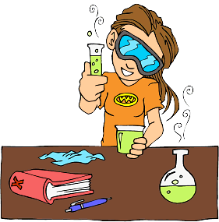
Good Methods: Science
Induction
scientists measure the speed of light 1000 times
it’s always found to be the same
it very likely will be the same the next time they measure it
Testing Predictions
your belief implies that X should be true about the world
conduct an experiment or do research to check if X is true

Slide 18
Good Methods: Other
Bayes’ Rule
how strongly does your evidence support a hypothesis?
ask how much more likely that evidence would be to occur if the hypotheses were true than if it weren’t
Using Your Gut (Wisely)
Trust it only where repeated experience has shown it to be reliable
Disproving Yourself
come up with your strongest arguments against what you believe
ask the smartest people you know for their best arguments against your beliefs
See: LessWrong.com for a lot more about good methods

Slide 19
Advantage of Good Methods
These methods make your beliefs truer
Provide a justification for believing your beliefs instead of other people’s
If your methods for determining your beliefs are better than someone else’s, your beliefs really will be more accurate!

Slide 20
My Problem
Many of my beliefs weren’t from good methods
Many were
generalizations from a few examples
things I’d read or been taught but hadn’t checked
beliefs based on intuition unchecked by reasoning
Realized I should carefully reexamine my beliefs trying to use good methods

Slide 21
How About You?
How sure are you that your beliefs have been formed primarily using good methods?
It’s healthy to revisit our beliefs from time to time
Exercise:
Write down a few of your important beliefs
Go through each and ask “How did I come to believe this?”
See if you honestly did use good methods

Slide 22
Story 3 Changing My Mind
Made a list of major beliefs I’d changed my mind about
Realized I’d flipped on many important opinions
Realized I would likely change on many more

Slide 23
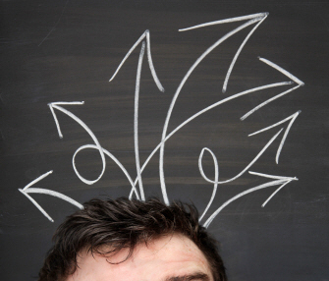
My Problem
If a number of my important beliefs will likely change, how can I trust the ones I have now?
Each belief feels so true yet some will be false
Since we don’t know which will be which, that means we should downgrade our belief in each of our beliefs!

Slide 24
People’s Beliefs Do Change Dramatically
Conservatives who could never imagine being liberal sometimes become liberals
Liberals who could never imagine being conservative sometimes become conservatives
People who were devout Christians now go to Skepticon!

Slide 25
Three Stories Converge
My thoughts are often irrational when I’m emotional
I need to rely on solid truth finding methods if I am going to trust my beliefs rather than other people’s
I will likely change my mind many more times and so should believe less in each belief

Slide 26
Self-Skepticism
Doubted my beliefs are as accurate as they feel
Doubted I understood my decision making
Doubted I understood my strengths and weaknesses

Slide 27
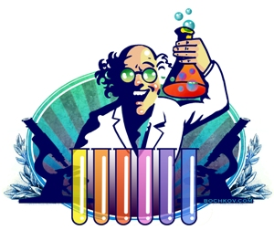
Investigating The Science
Does science support self-skepticism?
Let’s see what studies reveal about us humans
I’ll focus on our decision making and strengths and weaknesses

Slide 28
The Studies: Our Strengths And Weaknesses
How accurate are people’s perceptions about their strengths and weaknesses?
If generally not very accurate, we may have to make a special effort to understand them

Slide 29
Experimental Protocol
Ask people to evaluate themselves
Check to see if these evaluations are accurate or reasonable
If many are not, indicates poor self-knowledge

Slide 30
Surveys
93% of American Students claimed to be in the top 50% of driving skill
87% of Stanford M.B.A. students rated their academic performance as being in the top 50%
68% of teachers rated themselves as being in the top 25% of teaching ability
See: How Great We Are by Spencer Greenberg

Slide 31
Further Surveys
94% of University Professors thought they were better at their jobs than their average colleagues
nearly 50% of sociologists believed they would become among the top ten leaders in their field
Self-rated intelligence has fairly weak correlation (<0.30) with I.Q.
See: How Great We Are by Spencer Greenberg

Slide 32
Not Knowing Our Weaknesses
People overestimate their abilities in many ways
Underestimation of ourselves happens as well, especially when feeling depressed
Overestimation can make us
attempt tasks we can’t handle
not try to improve
Underestimation can make us
not try in the first place
give up easily

Slide 33
Not Knowing Our Knowledge
College students were able to predict the length of roommates’ relationships better than their own
Young male’s confidence in their knowledge about condom use barely correlated with actual knowledge
Physicians’ self-rated knowledge about thyroid disorders uncorrelated with thyroid knowledge quiz results
Source: Flawed Self-Assessment by Dunning, Heath, Suls

Slide 34
But there is hope…
We can use objective measures to assess ourselves (e.g. tests of skill)
We can introspect, searching for our flaws
We can seek out criticism from others to gain understanding

Slide 35
Improving Ourselves
Exercise to improve:
sit down, and make a list of ten of your biggest flaws
ask a close friend to add five more to the list
pick the 3 most important to work on during the next few months
ask your friend to hold you accountable

Slide 36
The Studies: How Do We Make Decisions?
We view our decisions as made for good reasons
When asked “why did you do that?” we think we can explain
Do studies confirm this intuition?

Slide 37
Population
Split
Randomly
½ Population
½ Population
Situation A
Situation B
A and B
Differ In One
Small Detail
Compare Behavior

Slide 38
Evaluating The Results
If behavior in the two groups is quite different
and the change made between the two situations is not something we would attribute a change in behavior to
then it indicates a poor understanding of our own decision making

Slide 39
1. Dating
Suppose a stranger asks you on a date, or asks you to dance at a club
What factors would influence whether you accept?
How good looking the person is
Whether you like his or her smile
How nice he or she seems

Slide 40
Touch
Would you say that the person touching you momentarily on the upper arm would be a major factor?
Good looking men asking women out doubled their success rate (from 10% to 20%) with a quick touch on the upper arm
In the “touch” group, half of the women who accepted the date would not have done it without the touch
50% more women accepted an offer to dance (43% vs. 65%) with a brief arm touch than without
Source: 59 Seconds by Richard Wiseman

Slide 41
2. Interviewing
Suppose you are interviewing a college student for a job
What factors would determine whether you hire?
grade point average
years of work experience
how responsible he or she seems

Slide 42
Ingratiation
In one study, no relationship was found between hiring recommendation and either G.P.A. or total work experience
What did matter is whether students tried to ingratiate themselves with the interviewer
We hire people we like, even at the cost of qualifications
Source: The Effect of Applicant Influence Tactics … by Higgins and Judge

Slide 43
3. Purchasing Decisions
You’d like to buy a magazine subscription
How do you decide between the cheaper web only version or more expensive print-and-web subscription?
Think about how often you’d read the paper copy if you had it
Think about what else you could spend the extra money on

Slide 44
Decoys
If a third option that is obviously worse than the print-and-web was also presented (same price, but gives you print and no web) would it change your mind?
Preferences switched from 32% selecting print-and-web to 84% choosing it when this “decoy” option was introduced
Decoy option, which was clearly worse than print-and-web, made print-and-web look better!
Source: Predictably Irrational by Dan Ariely

Slide 45
4. Criminal Sentences
You’re given the task of determining how long a prison sentence to give someone
How do you decide the length?
How much damage the crime caused
How premeditated the crime was

Slide 46
Beauty
How much do you think your sentencing would be altered by the person’s attractiveness?
College students asked to provide a sentence for a burglary gave sentences averaging about half as long if a beautiful photo was used for the criminal (2.8 years vs. 5.2 years)
We are subconsciously biased by beauty
Source: Beautiful but Dangerous by Sigall and Ostrove

Slide 47
Questioning Our Decisions
As seen in these studies, our behavior is often influenced by factors we are unaware of
We claim that we did an action for reason X, but reasons Y and Z may have influenced us without our knowledge
If seemingly irrelevant factors can play such a large role, how rational could our decisions really be?

Slide 48
How Can We Compensate?
If we know the subconscious factors that commonly influence decision making, we can try to compensate for them
Without this knowledge, we’re the slaves of subtle influences

Slide 49
Self-Skepticism Recap
“It often takes directed effort to understand our strengths and weaknesses”
We know because:
Large numbers of surveys indicate people have delusions about their strengths and weaknesses

Slide 50
Self-Skepticism Recap
“We’re often unaware of the real reasons for our actions”
We know because:
Large number of studies show behavior can be substantially altered by seemingly irrelevant factors

Slide 51
Self-Skepticism Recap
“Our beliefs are probably less accurate than they feel to us”
We know because:
Distorting of our thoughts when emotional
The disagreement of smart people
Failure of most everyone to just use good methods
Changing of our beliefs over time

Slide 52
Why Self-Skepticism?
To better understand your strengths and weaknesses
To understand your decisions and improve them
To end up with truer beliefs
SelfSkepticism.com

